Slide 1
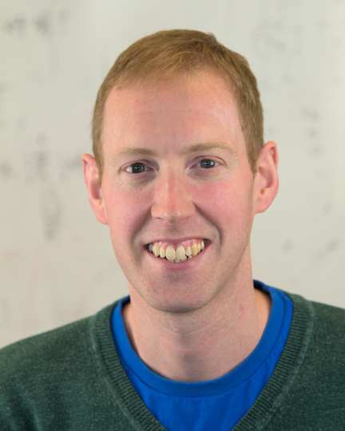
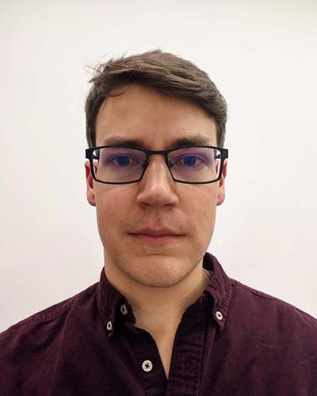
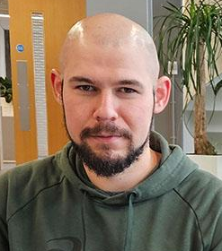
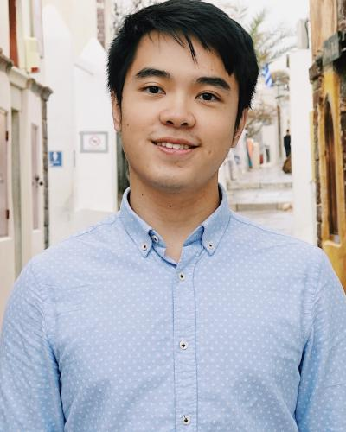



A practical introduction to programming the Cerebras CS-2 for HPC workloads
Nick Brown
EPCC University of Edinburgh
Joseph Lee
EPCC University of Edinburgh
Justs Zarins
EPCC University of Edinburgh
David Kacs
EPCC University of Edinburgh

Slide 2
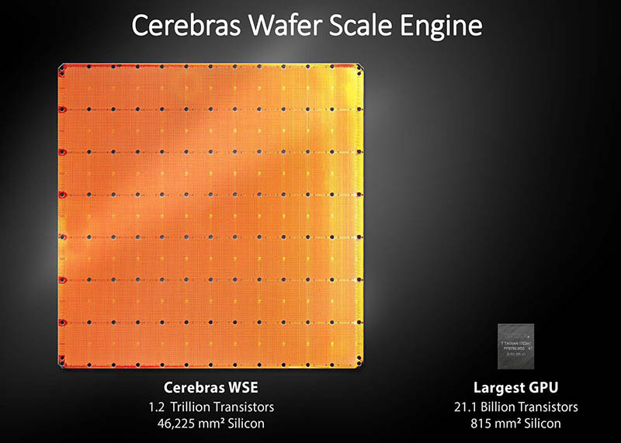
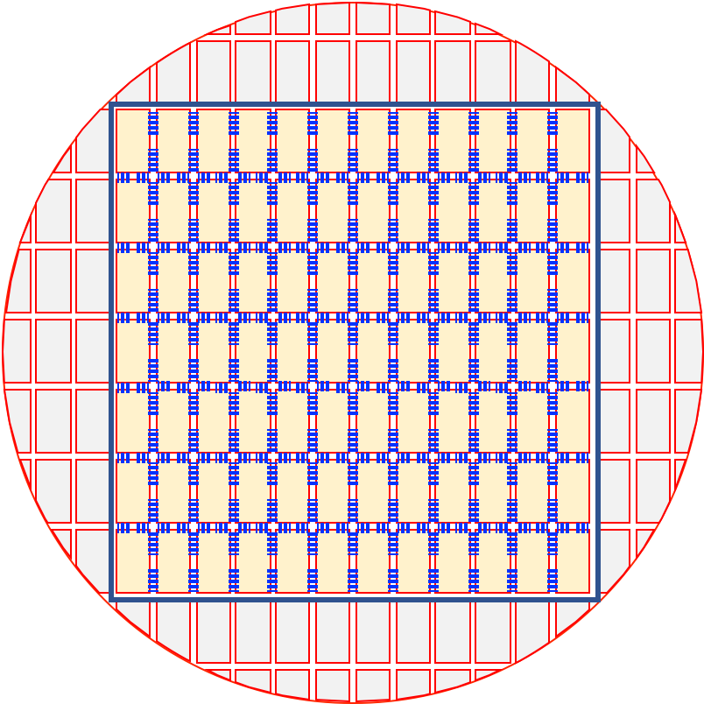
Motivation
Many HPC codes scale poorly across nodes
Such as FFT-based solvers, particle simulators, non-linear problems with iterative solvers
The CS-2 has a fabric that is high bandwidth and low-latency, allowing for excellent parallel efficiency for non-linear and highly communicative codes
The CS-2 system has 850k cores and can fit problems on an individual chip that take tens to hundreds of traditional small compute nodes.
Each core is individually programmable
Many HPC codes are constrained by data accesses
Such as Stencil based PDE solvers, linear algebra solvers, signal processing, sparse tensor math, big data analysis
The CS-2 system has 40 GB of SRAM uniformly distributed across the wafer that is 1 cycle away from the processing element (PE)
This speeds up memory access by orders of magnitude
The CS-2 system is capable of 1.2 Tb/s bandwidth onto the chip
Streaming data onto the chip as required

Slide 3
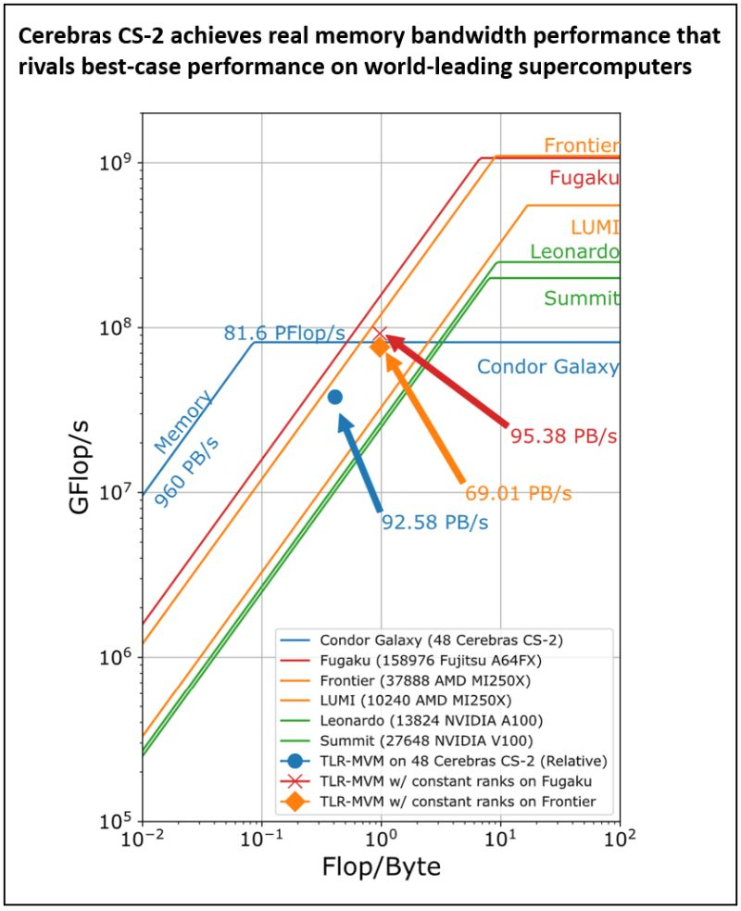




Example: Accelerating seismic modelling
The Ask: Deliver improved performance on seismic processing workload by leveraging Cerebras System’s unique architecture and massive on-chip memory.
Challenge: Seismic processing algorithms are typically memory-bound problems, limited by the memory access speeds of other architectures. Researchers were challenged to re-design an algorithm to take advantage of Cerebras hardware to improve performance.
What was done: Researchers used the Cerebras SDK to re-design a Tile Low-Rank Matrix-Vector Multiplication (TLR-MVM) algorithm to be optimized for Cerebras CS-2.
Outcome: Achieved a record sustained memory bandwidth of 92.58 Petabytes per second (PB/s) through the implementation of a TLR-MVM kernel that is uniquely tailored to exploit the architecture of the CS-2 systems.
More details at https://sc23.supercomputing.org/2023/08/a-look-at-the-2023-gordon-bell-prize-finalists/

Slide 4

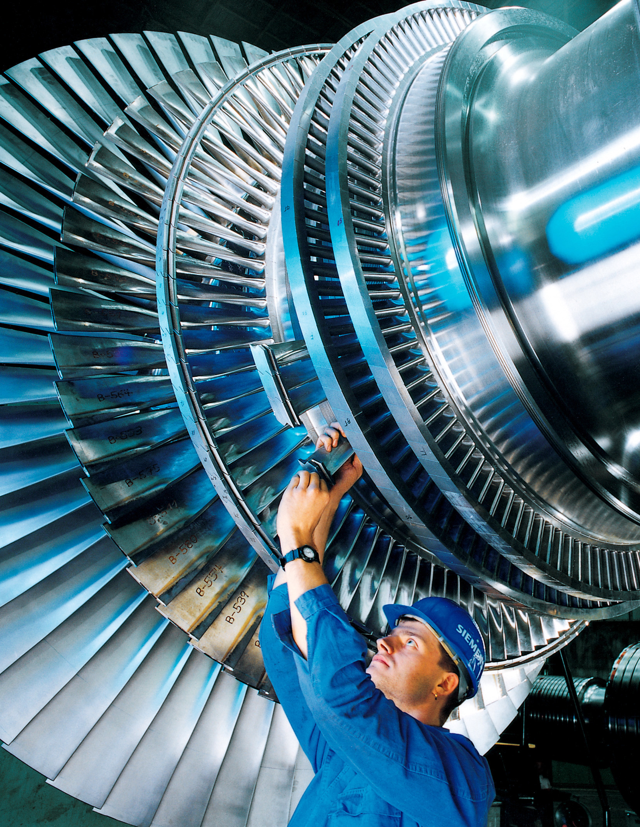
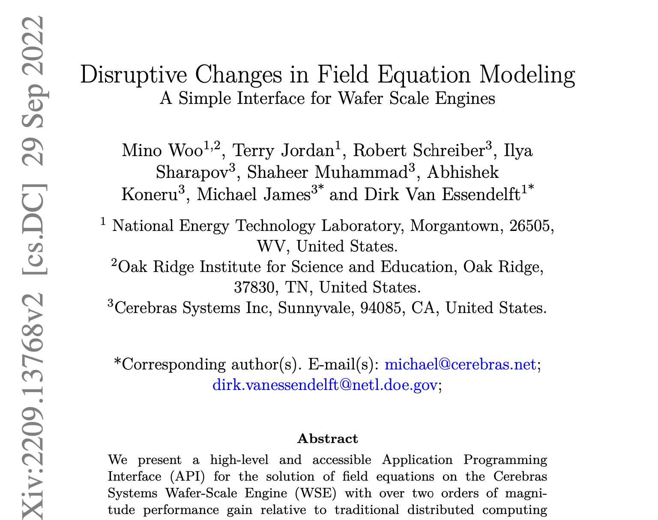
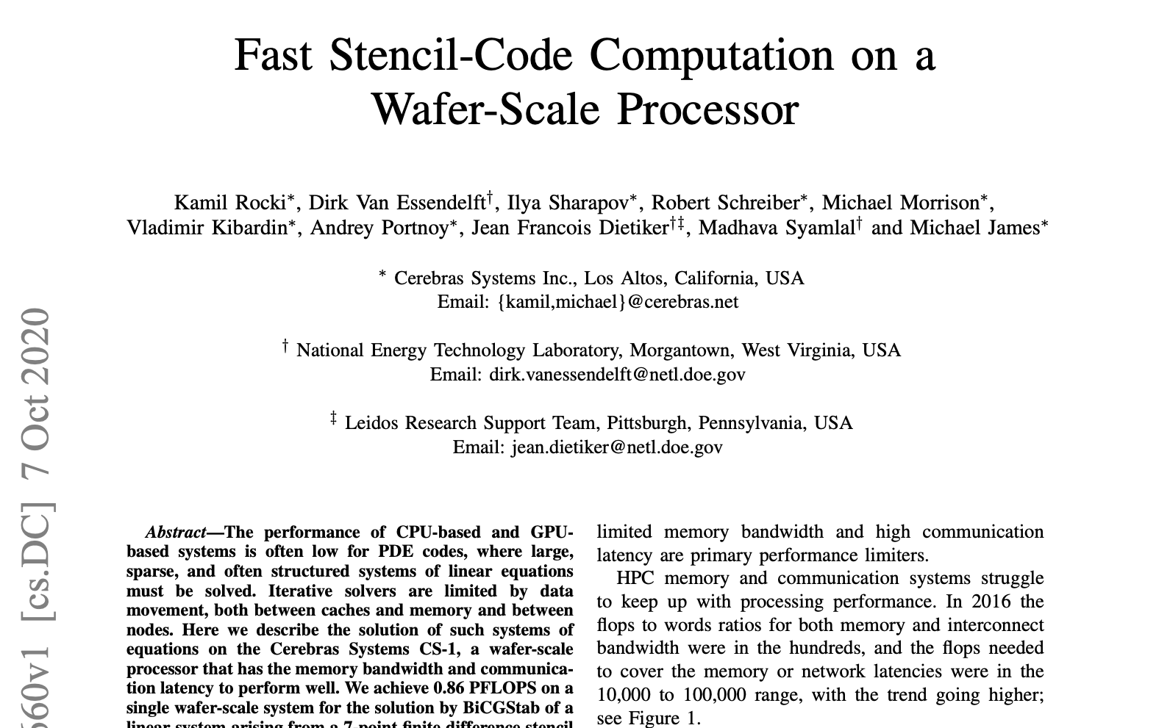
Example: Accelerating CFD
Cerebras and NETL demonstrate significant performance on a Cerebras CS-2 compared to CPU or GPU
CS-2 470x faster than Joule 2.0 supercomputer
Photo: Christian Kuhna, CC BY 3.0

Slide 5
Tutorial learning objectives
This tutorial is open to everybody, regardless of experience with HPC and accelerators
Is practically driven, where we will walk-through key concepts on the machine itself, and then you can explore the concepts more independently via a series of walk-throughs
Understand the CS-2 architecture & core concepts
We will explore the hardware, how it is designed the and key terminology
Get started with the Cerebras SDK
Exploring key concepts for writing HPC codes for the CS-2 and understanding how to build these
Writing multi-PE codes for the CS-2
Exploring how we can run over multiple PEs, have these communicate together and leverage the Cerebras collective communications library
Write programs for the CS-2 based on the hands-on activity
Bringing the concepts together and using these to develop a real code for the CS-2 and optimise it
Running on the CS-2 simulator
Much of development is done with a simulator, we will explore how to use this and leverage it when writing code
Running on a real CS-2 machine
Ultimately we want to accelerate our HPC codes on the CS-2, we will run our hands-on exercises on a real CS-2 machine
We are also happy to discuss your own applications and how these might be ported to the architecture

Slide 6
Session plan
Time | Title | Type
9:30 – 9:35 | Introduction, welcome and objectives | Presentation
9:35 – 9:55 | An Overview of the CS-2 architecture | Presentation
9:55 – 10:00 | Logging onto the CS-2 machine | Practical
10:00 – 11:00 | Practical walkthrough: Intro to SDK (CSL + Host Runtime) | Walk through
11:00 – 11:25 | Hands-on practical activity one & coffee | Practical
11:25 – 11:45 | Practical walkthrough: Using multiple PEs and communication | Walk through
11:45 – 12:15 | Hands-on practical activities two and three | Practical
12:15 – 12:25 | Wash up from practical activities | Presentation
12:25 – 12:30 | Conclusions and audience next steps to continue working with the technologies | Presentation
We will be doing the hands on and walk throughs sdf-cs1, more information about how to connect to that a little later

Slide 7
Materials and the CS-2 community
We will remind people as we progress through the session
All materials for this tutorial are open source and can be found at
https://github.com/EPCCed/cs2-sdk-training
More generally if you wish to continue exploring this after the tutorial finishes
https://sdk.cerebras.net/csl
There is a CS-2 developer community that you can join
Roughly monthly meetings
Forums: discourse.cerebras.net

